Slide 1

Research Progress Record
Enmao Diao
July 12, 2018

Slide 2
Abstract
Scene Change Detection
Neural Architecture Search
Kolmogorov superposition theorem

Slide 3
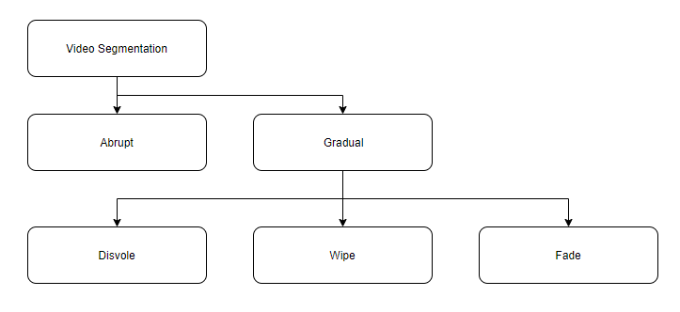
Detection of Scene Change in Video
Shot Boundary Detection is important overall for scene change detection.
Shot is defined as a part of the video that results from one continuous recording by a single camera. The gap between two shots is called a shot boundary.

Slide 4
Types
1. Abrupt-Abrupt transition occurs in a single frame.
2. Gradual-Gradual transitions are more difficult to detect as the difference between frames corresponding to two successive shots is substantially reduced
a. Fade: Two different kinds of fades are used: The fade-in and the fade-out. The fade-out emerges when the image fades to a black screen or a dot. The fade-in appears when the image is displayed from a black image. Both effects last a few frames.
b. Dissolve: It is a synchronous occurrence of a fade-in and a fade-out. The two effects are layered for a fixed period of time e.g. 0.5 seconds (12 frames). It is mainly used in live in-studio transmissions.
c. Wipe: This is a virtual line going across the screen clearing the old scene and displaying a new scene. It also occurs over more frames. It is commonly used in films such as Star Wars and TV shows.
d. Maybe more?

Slide 5
Data
TRECVID
seven TRECVID releases, from 2001 to 2007. They have a total of 3,831,648 frames, with 8,545 gradual and 14,602 abrupt transitions.[1]
BBC Planet Earth dataset
ground truth shots and scene annotation for each of the 11 eposides of the BBC Planet Earth educational TV Series. Each shot and scene has been manually annotated and verified by a set of human experts.[2]
RAI
987 shot boundaries, 724 of them being hard cuts and 263 gradual transitions. (600MB)[3]
[1] A. F. Smeaton, P. Over, and A. R. Doherty, “Video shot boundary detection: Seven years of trecvid activity,” Computer Vision and Image Understanding (CVIU) ), vol. 114, no. 4, pp. 411–418, 2010.
[2] Baraldi, Lorenzo, Costantino Grana, and Rita Cucchiara. "A Deep Siamese Network for Scene Detection in Broadcast Videos." In Proceedings of the 23rd Annual ACM Conference on Multimedia Conference, pp. 1199-1202. ACM, 2015.
[3] L. Baraldi, C. Grana, R. Cucchiara, Shot and scene detection via hierarchical clustering for re-using broadcast video, CAIP 2015

Slide 6
Methods
Classical [4]
Color Histograms
frame-to-frame similarities based on colors which appeared within them
Edge Detection
detecting edges in two neighboring images and comparing these images
etc
Deep Learning
CNN-based [5][6]
Metric
[1]
[4] Mithlesh, Chandra Shekhar, and Dolley Shukla. "Detection of Scene Change in Video. " 2013
[5] Hassanien, Ahmed, et al. "Large-scale, fast and accurate shot boundary detection through spatio-temporal convolutional neural networks." arXiv preprint arXiv:1705.03281 (2017).
[6] Gygli, Michael. "Ridiculously fast shot boundary detection with fully convolutional neural networks." arXiv preprint arXiv:1705.08214 (2017).

Slide 7
Deep Learning Architecture Search
Neural Architecture Search can design good models from scratch, an achievement considered not possible with other methods
Most methods treat architecture search as a black-box optimization problem over a discrete domain, which leads to a large number of architecture evaluations required. There also exists a school of thought searching architectures within a continuous domain

Slide 8
Previous work
Discrete
Reinforcement Learning[1][2]
Evolutionary Algorithm[3]
Monte Carlo Tree Search(MCTS)[4]
Sequential Model Based Optimization (SMBO)[5][6]
Continuous
Modular multi-branch Architecture[7]
Weighted Model[8]
Exponential Weighted Model[9]

Slide 9
Discrete
Reinforcement Learning（NASNet）
A RNN controller to generate CNN hyperparameters like convolution filter size and convolution stride size as a sequence of tokens
The process of generating an architecture stops if the number of layers exceeds a certain value(will increase as training progresses)
The parameters of the controller RNN are optimized in order to maximize the expected validation accuracy of the proposed architectures.
Takes about 1800 GPU days to finish. Accelerate Training with Parallelism and Asynchronous Updates

Slide 10
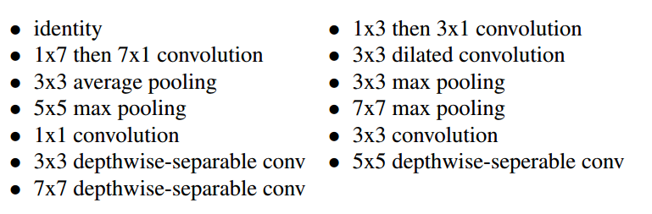
Discrete
Reinforcement Learning
Define a Discrete Search Space for Future work

Slide 11
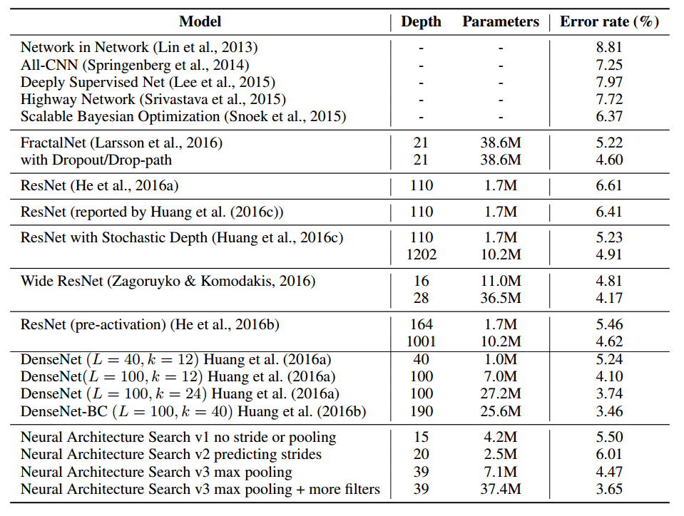
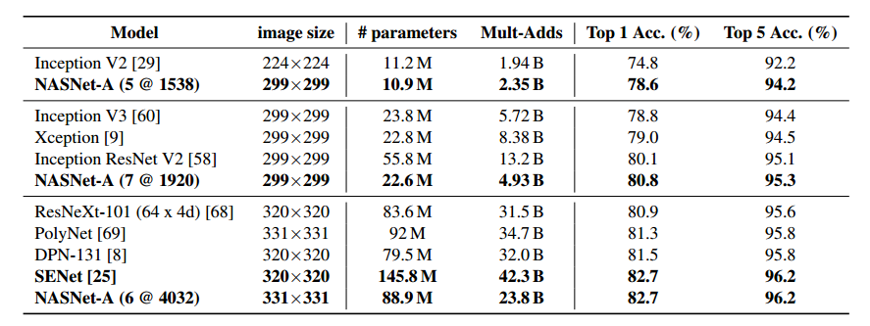
Discrete
Reinforcement Learning
CIFAR-10 ImageNet

Slide 12
Discrete
Regularized Evolution
Use NASNet search space.
A variant of the standard tournament selection method
At each iteration, a sample of S models is selected at random. The best model of the sample is mutated to produce a child with an altered architecture, which is trained and added to the population. The oldest/worst model in the population is discarded
Takes 3500 GPU days

Slide 13
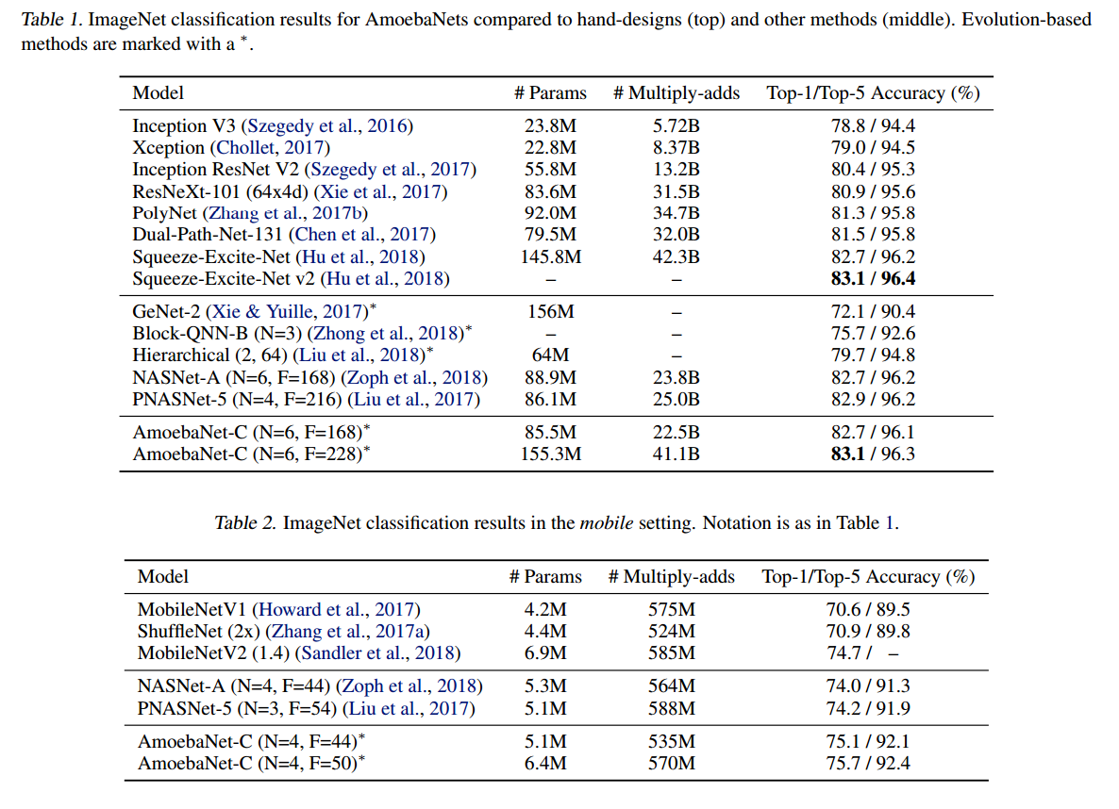
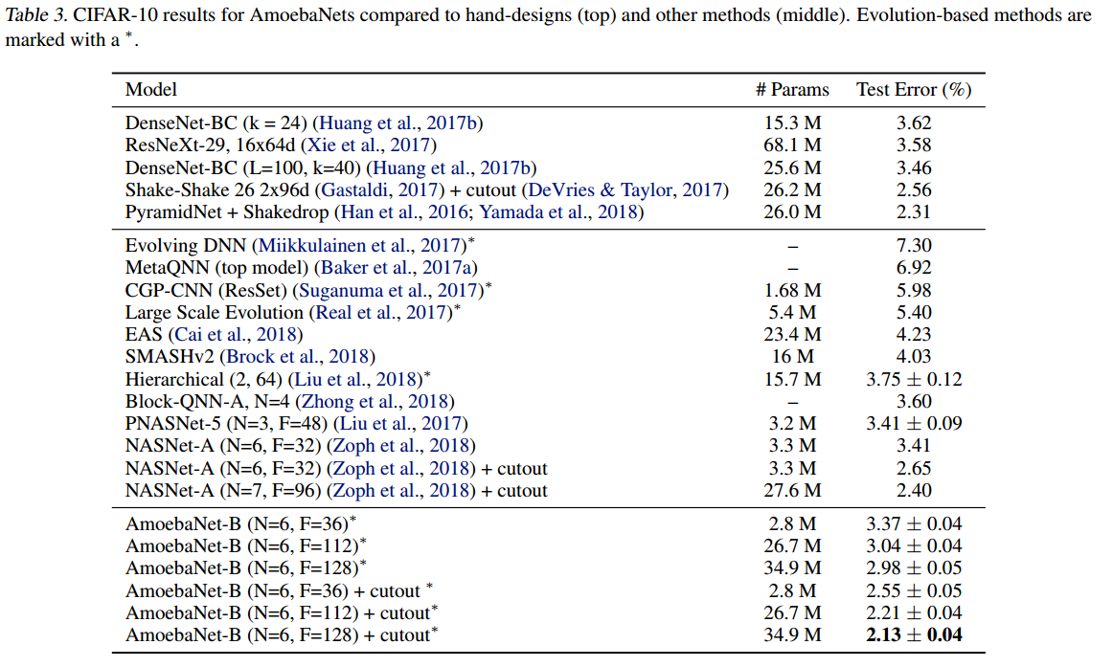
Discrete
Regularized Evolution
convolution channel depth (F) and cell stacking depth (N)
Number of features (F), Number of Layers (N) as hyperparemeters
CIFAR-10 ImageNet

Slide 14
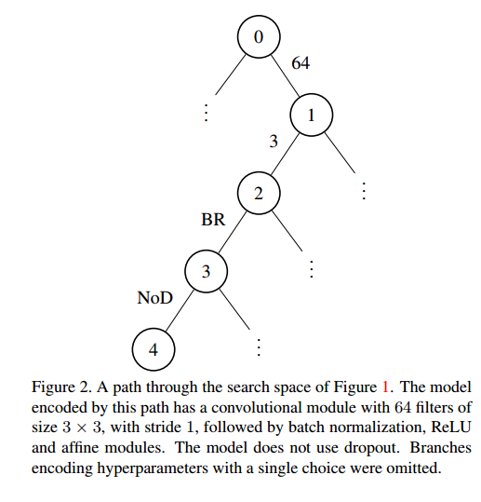
Discrete
Monte Carlo Tree Search (MCTS)
The search space is only in Convolution but extend to number of parameters
Similar to RL approach set up. MCTS is the main search algorithm

Slide 15
Discrete
Sequential Model Based Optimization (SEBO)
Introduce a surrogate function(e.g. Ridge Regressor) to capture relationships between models and how promising it is to evaluate any specific model.
The surrogate function can optimized to choose which model to evaluate next.
Optimize the surrogate function over search space is hard.
5 times fewer model evaluations than RL, also claims faster than MCTS

Slide 16
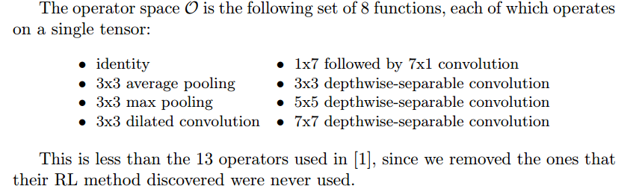
Discrete
Sequential Model Based Optimization (SEBO)
Exists many work that uses a surrogate function. They claim they are the first to do that in this large search space (smaller than NASNet)

Slide 17
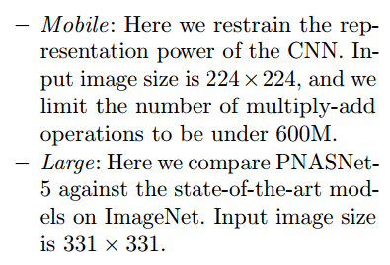
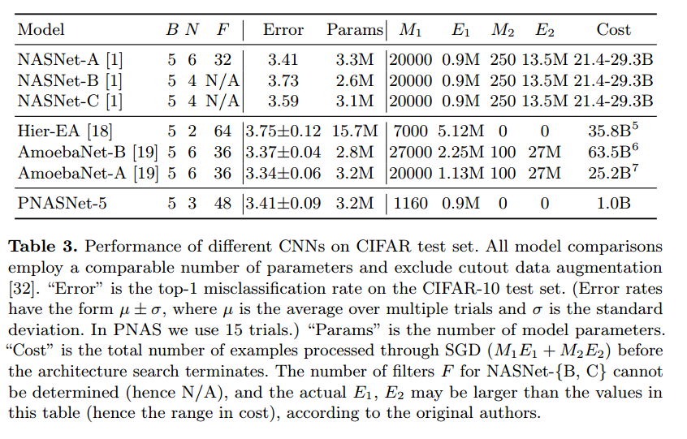
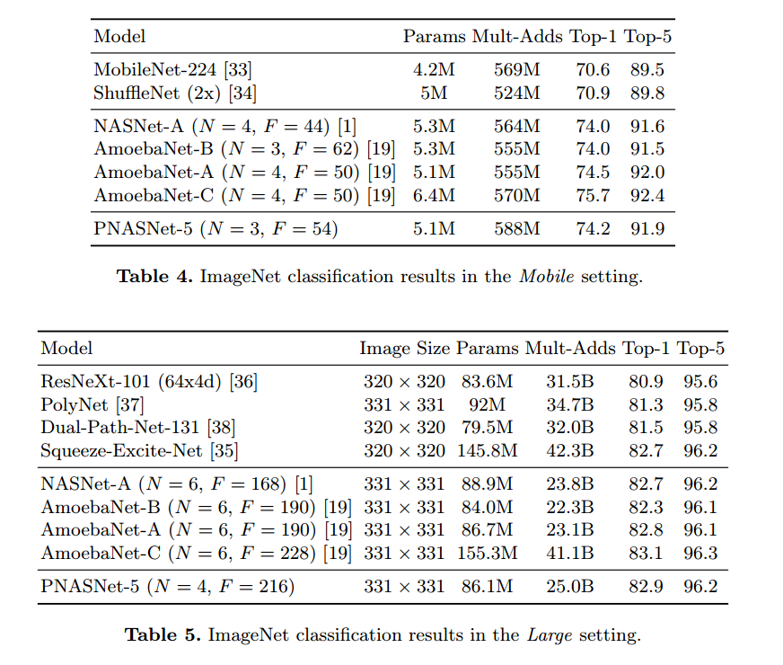
Discrete
Sequential Model Based Optimization (SEBO)
CIFAR-10 ImageNet

Slide 18

Continuous
Connectivity Learning in Multi-Branch Networks
Propose an algorithm to learn the connections between branches(groups) in the network
The input of each group convolution is controlled by a binary gate vector that is learned jointly with the weights of the network.
Gate is parametrized by a parameter within [0,1] (clipping when doing gradient descent). Normalize them to sum to 1. Sample K Multinomial from C gates where K denotes the predefined number of active gate at the same time in a branch/group

Slide 19
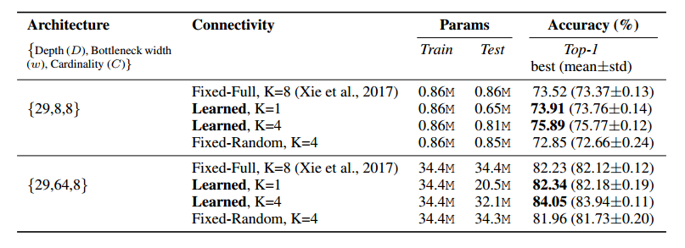
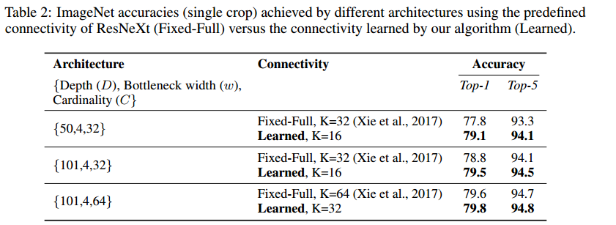
Continuous
Connectivity Learning in Multi-Branch Networks
CIFAR-100 ImageNet

Slide 20

Continuous
Differentiable Neural Network Architecture Search
Handle different number of filter sizes, number of channels, grouped convolution by introducing more parameters
where ∗ is the convolution operator, n, m are numbers of possible filter sizes and channel counts. Have to enforce parameter sharing to reduce the number of parameters and introduce even more parameters for grouped convolution
the first three layers can select from filter height/width {1, 2, 3, 4, 5}, the next two from {1, 2, 3}, while the fully-connected layers can only select the number of input channels
Only tested on Udacity Dataset (self-driving dataset)

Slide 21

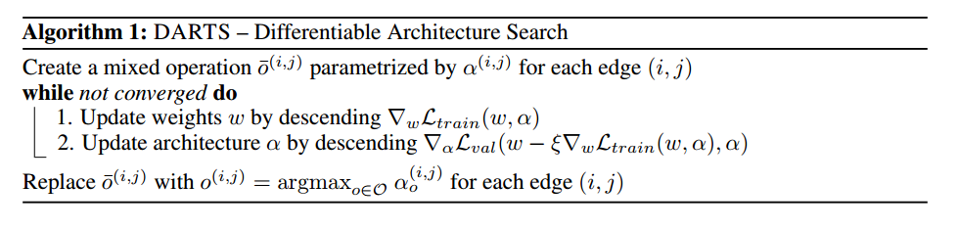
Continuous
DARTS: Differentiable Architecture Search
Parametrized on each candidate model with a softmax function
Finish within one GPU day

Slide 22
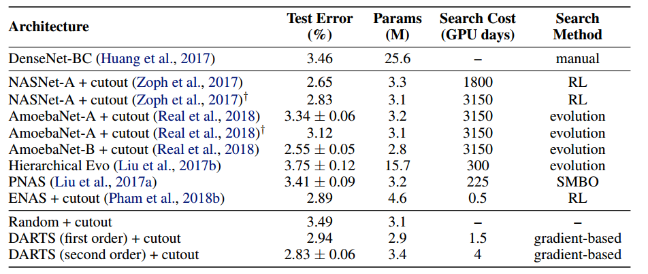
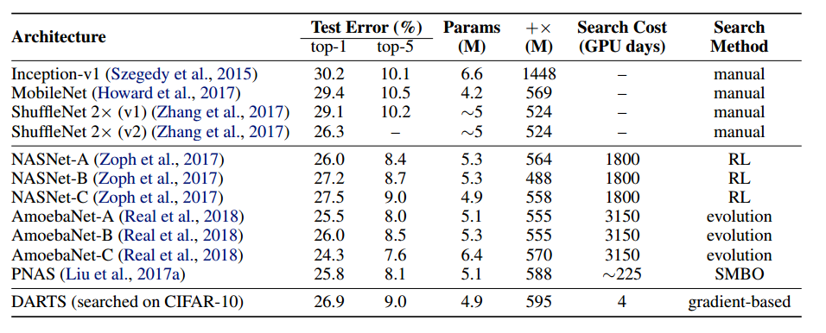
Continuous
DARTS: Differentiable Architecture Search
CIFAR-10 ImageNet

Slide 23
Summary
Discrete
Slow
Perform well on larger dataset
More flexible on choosing search space
Need extra technique like parameter sharing to speed up optimization
Continuous
Fast
Perform well on smaller dataset
Search space restricted to specific construction
Introduce extra parameters that may cause overfitting and redundancy

Slide 24
Reference
[1] Barret Zoph and Quoc V Le. Neural architecture search with reinforcement learning. arXiv preprint arXiv:1611.01578, 2016.
[2] Barret Zoph, Vijay Vasudevan, Jonathon Shlens, and Quoc V Le. Learning transferable architectures for scalable image recognition. arXiv preprint arXiv:1707.07012, 2017.
[3] Esteban Real, Alok Aggarwal, Yanping Huang, and Quoc V Le. Regularized evolution for image classifier architecture search. arXiv preprint arXiv:1802.01548, 2018.
[4] Renato Negrinho and Geoff Gordon. Deeparchitect: Automatically designing and training deep architectures. arXiv preprint arXiv:1704.08792, 2017.
[5] Chenxi Liu, Barret Zoph, Jonathon Shlens, Wei Hua, Li-Jia Li, Li Fei-Fei, Alan Yuille, Jonathan Huang, and Kevin Murphy. Progressive neural architecture search. arXiv preprint arXiv:1712.00559, 2017a.
[6] Hutter, Frank, Holger H. Hoos, and Kevin Leyton-Brown. "Sequential model-based optimization for general algorithm configuration." International Conference on Learning and Intelligent Optimization. Springer, Berlin, Heidelberg, 2011.
[7] Karim Ahmed and Lorenzo Torresani. Connectivity learning in multi-branch networks. arXiv preprint arXiv:1709.09582, 2017.
[8] Richard Shin, Charles Packer, and Dawn Song. Differentiable neural network architecture search. In Workshop at International Conference on Learning Representations, 2018.
[9] DARTS: Differentiable Architecture Search Hanxiao Liu, Karen Simonyan, Yiming Yang. arXiv:1806.09055.

Slide 25
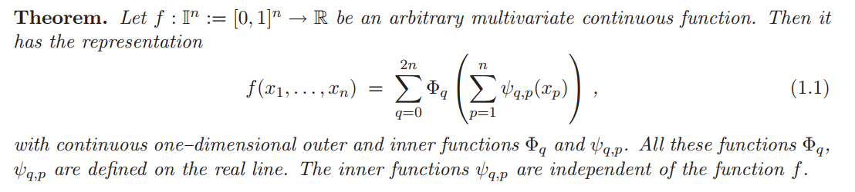
Kolmogorov superposition theorem
The original work was given in 1957[1]. After numerous improvements and variation. A constructive proof and summary is given in 2009[2]
Moreover, the functions φ_qp universal for the given dimension n; they are independent of f. Only the functions Φ_q are specific for the given function f. Several authors have improved on Kolmogorov's representation. Lorentz (1966) showed that the functions Φ_q can be replaced by only one function PHI and Sprecher( 1965 ) replaced the functions φ_qp by λ_qp* φ_p, where λ_qp is a constant and φ_p are monotonic increasing functions. Sprecher Later develop a numerical implementation of Kolmogorov superposition theorem and later the convergence of this algorithm proves the constructive theorem.[7]

Slide 26
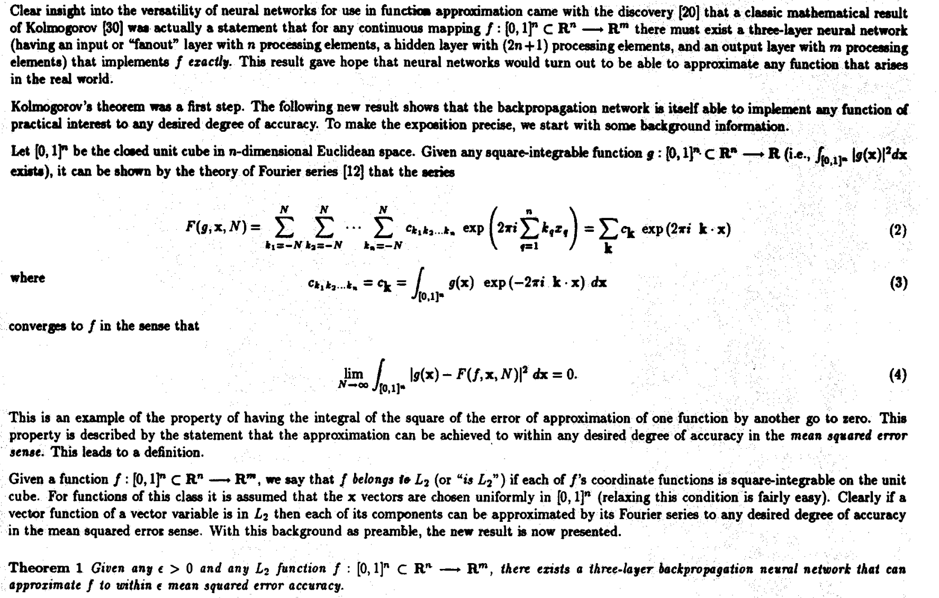
Kolmogorov superposition theorem
Theory of the backpropagation neural network
Kolmogorov’s superposition theorem found attention in neural network computation by Hecht–Nielsen’s interpretation as a feed-forward network with an input layer, one hidden layer and an output layer.[2]

Slide 27
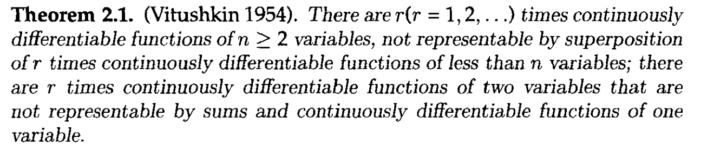
Kolmogorov superposition theorem
Representation properties of networks Kolmogorov’s theorem is irrelevant
However, the inner functions in all these versions of Kolmogorov’s theorem are highly non-smooth. Also, the outer functions depend on the specific function f and hence are not representable in a parameterized form. Moreover, all one–dimensional functions are the limits or sums of some infinite series of functions, which cannot be computed practically. Therefore Girosi and Poggio made the criticism that such an approach is not applicable in neurocomputing.[3]

Slide 28
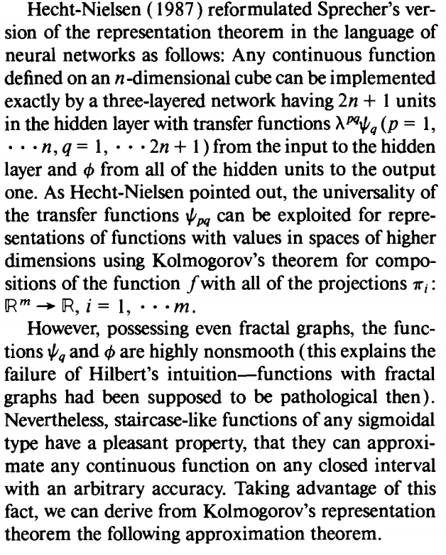
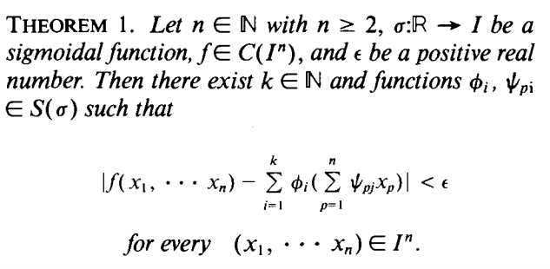
Kolmogorov superposition theorem
Kolmogorov’s theorem is relevant
Kolmogorov’s theorem and multilayer neural networks

Slide 29
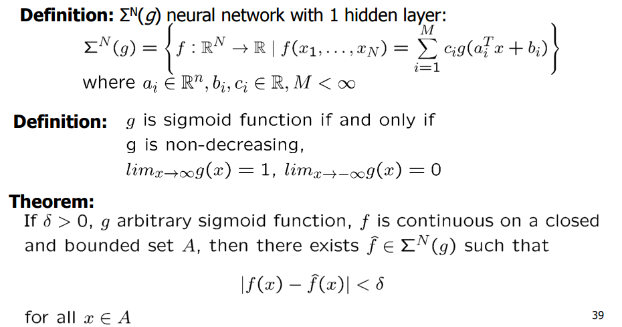
Kolmogorov superposition theorem
Universal Approximators[6]

Slide 30
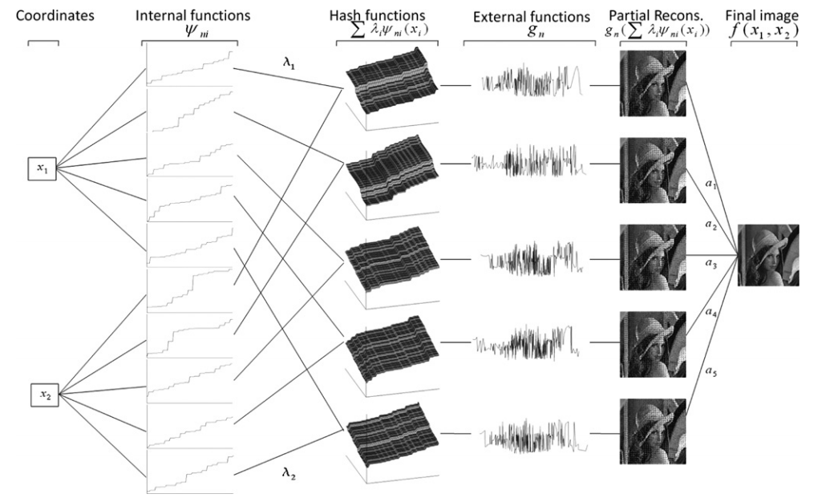
Kolmogorov superposition theorem
Kolmogorov superposition theorem for image compression[8]

Slide 31
Reference
[1] A. N. Kolmogorov. On the representation of continuous functions of many variables by superpositions of continuous functions of one variable and addition. Doklay Akademii Nauk USSR, 14(5):953 – 956, 1957.
[2] Braun, Jürgen, and Michael Griebel. "On a constructive proof of Kolmogorov’s superposition theorem." Constructive approximation 30.3 (2009): 653.
[3] Hecht-Nielsen, R. (1987). Kolmogorov's mapping neural network existence theorem. In Proceedings of the International Conference on Neural Networks, ( III, 11-14 ). New York: IEEE Press.
Hecht-Nielsen, R. (1989). Theory of the back-propagation neural network. In Proceedings of the International Joint Conference on Neural Networks, (I, 593-608 ). New York: IEEE Press.
Hecht-Nielsen, R. (1990). Neurocomputing. New York: AddisonWesley Publishing Company.
[4] F. Girosi and T. Poggio. Representation properties of networks: Kolmogorov’s theorem is irrelevant. Neural Comp., 1:465 – 469, 1989.
[5] V. Kurkova. Kolmogorov’s theorem is relevant. Neural Computation, 3:617 – 622, 1991.
V. Kurkova. Kolmogorov’s theorem and multilayer neural networks. Neural Networks, 5:501 – 506, 1992.
[6] Cybenko, George. "Approximation by superpositions of a sigmoidal function." Mathematics of control, signals and systems 2.4 (1989): 303-314.
Hornik, Kurt, Maxwell Stinchcombe, and Halbert White. "Multilayer feedforward networks are universal approximators." Neural networks 2.5 (1989): 359-366.
Hornik, Kurt. "Approximation capabilities of multilayer feedforward networks." Neural networks 4.2 (1991): 251-257.
[7] D. A. Sprecher. On the structure of continuous functions of several variables. Transactions Amer. Math. Soc, 115(3):340 – 355, 1965.
D. A. Sprecher. An improvement in the superposition theorem of Kolmogorov. Journal of Mathematical Analysis and Applications, 38:208 – 213, 1972.
Sprecher, David A. "A universal mapping for Kolmogorov's superposition theorem." Neural Networks 6.8 (1993): 1089-1094.
Katsuura, Hidefumi, and David A. Sprecher. "Computational aspects of Kolmogorov's superposition theorem." Neural Networks 7.3 (1994): 455-461.
D. A. Sprecher. A numerical implementation of Kolmogorov’s superpositions. Neural Networks, 9(5):765 – 772, 1996.
D. A. Sprecher. A numerical implementation of Kolmogorov’s superpositions II. Neural Networks, 10(3):447 – 457, 1997.
Brattka, Vasco. "A computable Kolmogorov superposition theorem." Computability and Complexity in Analysis. Informatik Berichte 272 (2003): 7-22.
[8] Leni, P-E., Y. D. Fougerolle, and Frederic Truchetet. "Kolmogorov superposition theorem for image compression." IET Image Processing 6.8 (2012): 1114-1123.

